Slide 1

Kick starter
Crowd funding

Slide 2

What is Crowdfunding
Crowdfunding Definition: Crowdfunding is a method of raising funds by collecting small contributions from a large number of people, typically using online platforms.
Key Features:
Accessibility for creators
Engages communities
Innovative funding approach
Why Crowdfunding Matters:
Supports entrepreneurial ideas
Empowers social and creative projects
Provides alternative financing solutions

Slide 3
Crowdfunding Platforms
Popular Platforms:
Kickstarter: Focused on creative and innovative projects.
Indiegogo: Open to a broader range, including tech.
GoFundMe: Suitable for personal and charitable causes.
Patreon: Tailored for creators and artists, this platform enables recurring support from fans.
Fundly: Great for personal and social causes, with an easy setup.
Chuffed: Designed for non-profit projects and social enterprises.
SeedInvest: Ideal for startups looking for equity crowdfunding.

Slide 4
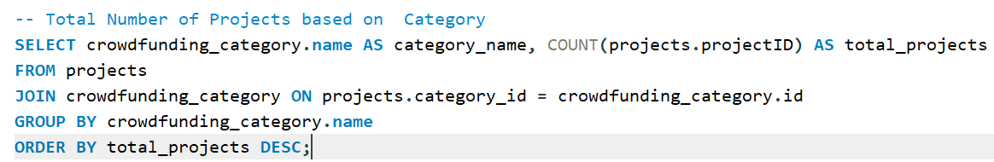
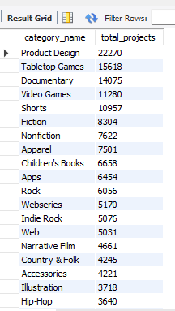

Slide 5
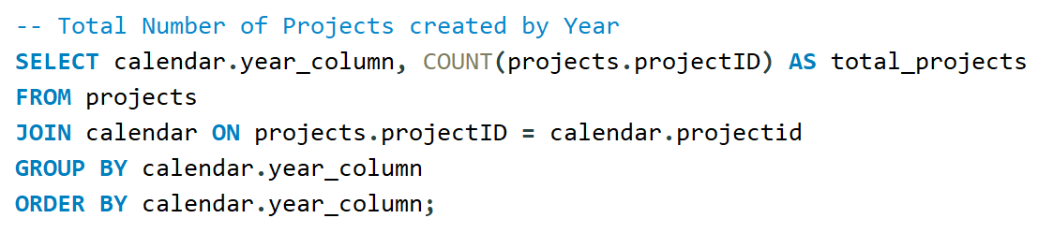
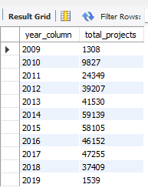

Slide 6
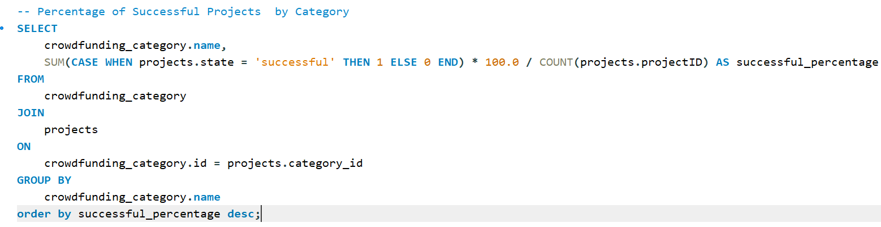
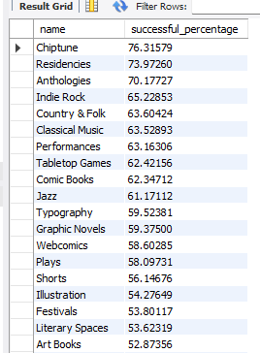

Slide 7
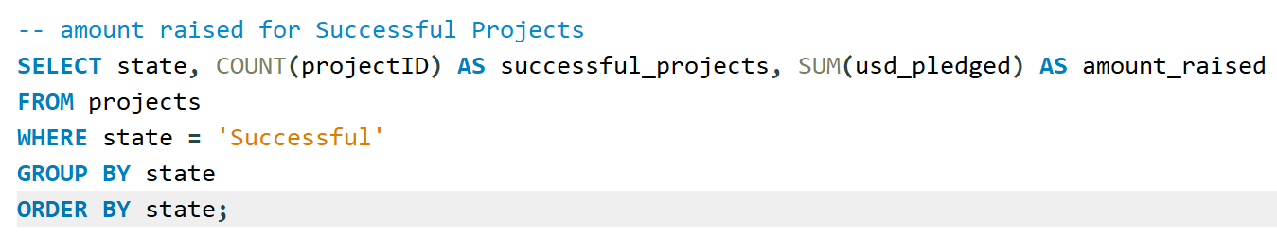


Slide 8
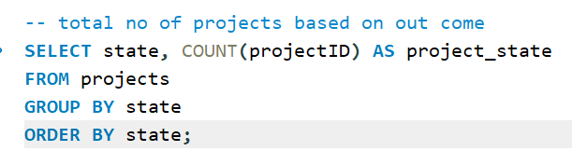
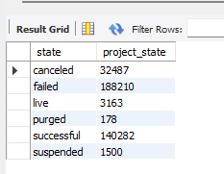

Slide 9
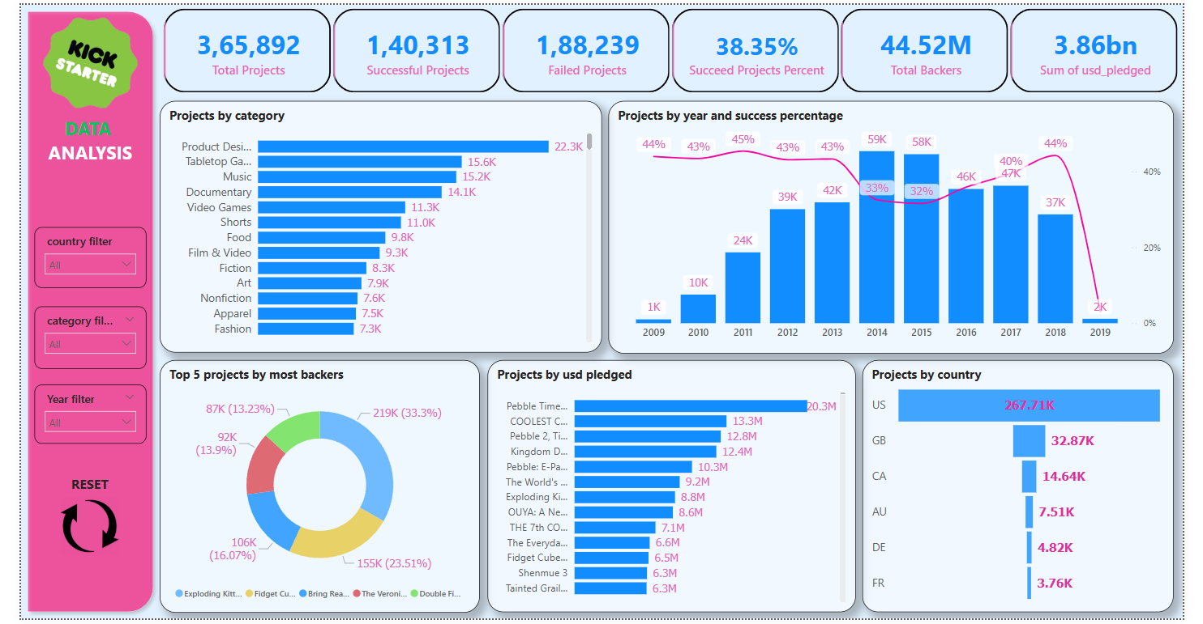
DASHBOARD

Slide 10
Dataset Insights
Objective: Understanding trends from the crowdfunding dataset.
Insights:
Total projects analyzed by:
Outcome: Successful, failed, and canceled.
Category: product design, table top games, documentary etc.
Location: Most active countries.
Trends:
By Year: Growth and decline in projects over time From 2009 to 2019.
By Category: Categories with higher success rates.
By Location: Identifying hotspots for crowdfunding activity.

Slide 11
conclusion
1
Kickstarter Crowdfunding continues to grow as a popular way to fund ideas.
2
found that high goals correlate with lower success rates.
3
Categories like product design and table top games have higher success rates.
4
It takes an average of 80 days for a successful projects.
5
Certain locations like US and CANADA dominate in activity and success.

Slide 12
Recommendations
Strategies for Success:
Focus on Successful Categories:
Invest in popular and promising categories with high success rates.
Improve Campaigns:
Include engaging content to attract backers.
Optimize Goal Ranges:
Set realistic goals that align with successful funding patterns.

Slide 13
THANK YOU

